Slide 1
Filtered backprojection algorithm using CT image
Shtepa Olga

Slide 2
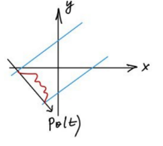
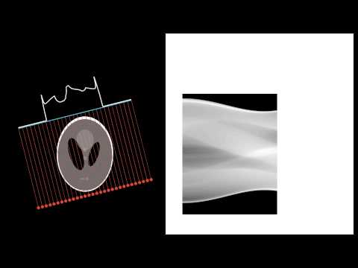
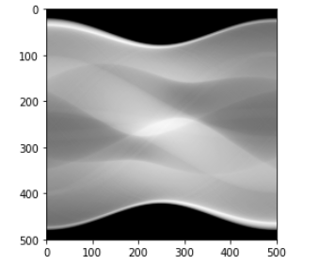
Sinogram

Slide 3
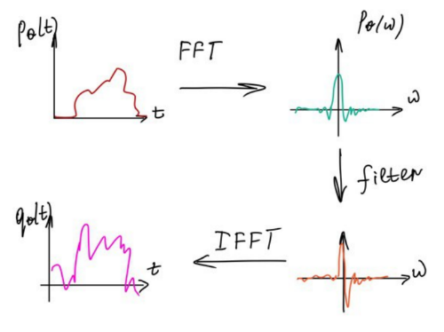
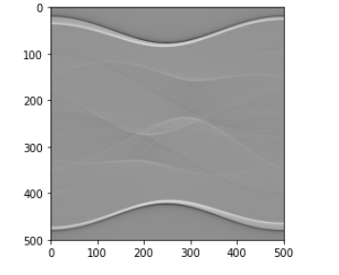
Filtering

Slide 4
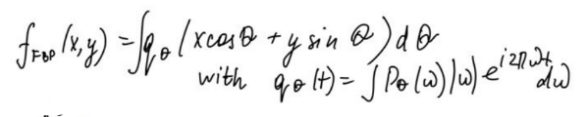
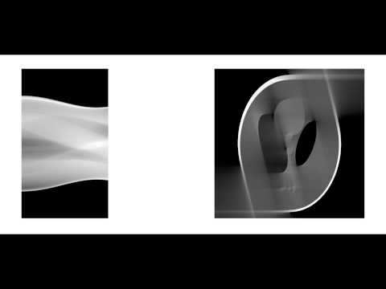
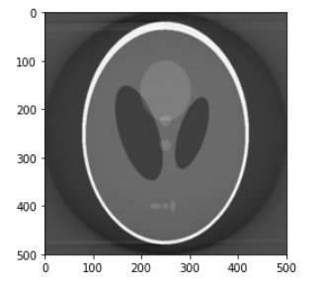
Backprojection

Slide 5
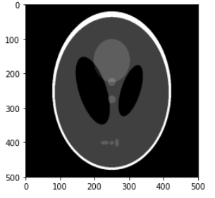
Original image
Result
Sinogram
Filtering

Slide 6
Optimization
Sinogram | Filter | Backprojection
1.055931568145752 | 0.04346036911010742 | 9.431044340133667

Slide 7
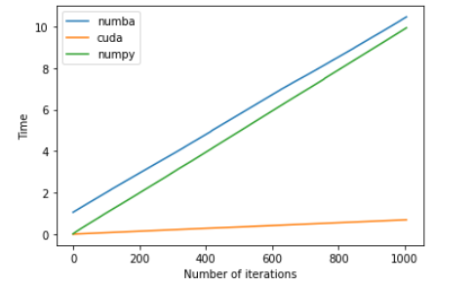
Optimization

Slide 8
Thank you for your attention!

Slide 9
Link on code
https://colab.research.google.com/drive/1foKsjkrPYKE_udmhLT3cYzLOOE88pcHR?usp=sharing

